Slide 1

RUNGTA COLLEGE OF DENTAL SCIENCES AND RESEARCH
REGENERATIVE ENDODONTICS
DEPARTMENT OF CONSERVATIVE DENTISTRY AND ENDODONTICS

Slide 2
Specific learning Objectives
At the end of this presentation the learner is expected to know ;
Core areas* | Domain ** | Category #
Introduction | Cognitive | Nice to know
Definitions | Cognitive | Must know
Indications | Cognitive | Must know
Single vs Multiple visit endodontics | Cognitive | Must know

Slide 3
CONTENT
INTRODUCTION
HISTORY
DEFINITIONS
PRESENT SCENARIO OF REGENERATIVE ENDODONTICS
GOALS & OBJECTIVES
TRILOGY OF REGENERATION
Stem Cells
Growth Factors/Morphogens
Scaffolds
Delivery System
CLINICAL STUDIES ON REGENERATIVE ENDODONTICS
Clinical Procedures Related to Regenerative Endodontics
Overview of Clinical Revascularization Cases
AAE Revascularization Protocol
Newer Approaches for regenerative endodontics
Clinical Measures of Treatment Outcome
CONCLUSION
REFERENCES

Slide 4
AAE Clinical Considerations for a Regenerative Procedure
Case Selection:
Tooth with necrotic pulp and an immature apex.
Pulp space not needed for post/core, final restoration.
Compliant patient/parent.
Patients not allergic to medicaments and antibiotics necessary to complete procedure (ASA 1 or 2).

Slide 5
Informed Consent
Two (or more) appointments.
Use of antimicrobial(s).
Possible adverse effects: staining of crown/root, lack of response to treatment, pain/infection.
Alternatives: MTA apexification, no treatment, extraction (when deemed non salvageable).
Permission to enter information into AAE database (optional).

Slide 6
First Appointment
then irrigated with saline or EDTA (20 mL/canal, 5 min)
Dry canals with paper points.
Local anesthesia, dental dam isolation and access.
Copious, gentle irrigation with 20ml/Canal NaOCl
Notes:
Copious, gentle irrigation with 20ml NaOCl using an irrigation system that minimizes the possibility of extrusion of irrigants into the periapical space (e.g., needle with closed end and side-vents, or EndoVac™). Lower concentrations of NaOCl are advised [1.5% NaOCl (20mL/canal, 5 min) and then irrigated with saline or EDTA (20 mL/canal, 5 min), with irrigating needle positioned about 1 mm from root end, to minimize cytotoxicity to stem cells in the apical tissues.

Slide 7
Intracanal medicament
Calcium hydroxide
Antibiotic Paste
Seal with 3-4mm of temporary material
Notes:
Place calcium hydroxide or low concentration of triple antibiotic paste. If the triple antibiotic paste is used: 1) consider sealing pulp chamber with a dentin bonding agent [to minimize risk of staining] and 2) mix 1:1:1 ciprofloxacin: metronidazole: minocycline to a final concentration of 0.1-1.0 mg/ml. Triple antibiotic paste has been associated with tooth discoloration. Double antibiotic paste without minocycline paste or substitution of minocycline for other antibiotic (e.g., clindamycin; amoxicillin; cefaclor) is another possible alternative as root canal disinfectant.
Deliver into canal system via syringe. If triple antibiotic is used, ensure that it remains below CEJ (minimize crown staining). Seal with 3-4mm of a temporary restorative material such as Cavit™, IRM™, glassionomer or another temporary material. Dismiss patient for 1-4 weeks.

Slide 8
Second appointment(1-4 weeks after 1st visit)
Assess response to initial treatment
Sign & symptoms of infection persists
Additional treatment time
Alternative antimicrobial
Signs & symptoms relieved
revascularization

Slide 9
Local anesthesia and rubber dam isolation
Irrigation with 20ml of 17% EDTA, drying the canal with paper points
Intentionally evoked intracanal bleeding (k-file passively extended 2mm past the apical foramen)
Canal filled with blood to the level of the CEJ
Stop the bleeding at a level that allows for 3-4 mm of the restorative material
Placement of a resorbable matrix over the blood clot
White MTA/CaOH2 as capping material covered with 3-4 mm layer of GIC
Notes:
Create bleeding into canal system by over-instrumenting (endo file, endo explorer) (induce by rotating a pre-curved K-file at 2 mm past the apical foramen with the goal of having the entire canal filled with blood to the level of the cemento–enamel junction). An alternative to creating of a blood clot is the use of platelet-rich plasma (PRP), platelet rich fibrin (PRF) or autologous fibrin matrix (AFM).
Stop bleeding at a level that allows for 3-4 mm of restorative material.
Place a resorbable matrix such as CollaPlug™, Collacote™, CollaTape™ over the blood clot if necessary and white MTA as capping material.
A 3–4 mm layer of glass ionomer (e.g. Fuji IX™, GC America, Alsip, IL) is flowed gently over the capping material and light-cured for 40 s. MTA has been associated with discoloration. Alternatives to MTA (such as bioceramics or tricalcium silicate cements [e.g., Biodentine®, Septodont, Lancasted, PA, USA]) should be considered in teeth where there is an esthetic concern. o Anterior and Premolar teeth - Consider use of Collatape/Collaplug and restoring with 3mm of a nonstaining restorative material followed by bonding a filled composite to the beveled enamel margin. o Molar teeth or teeth with PFM crown - Consider use of Collatape/Collaplug and restoring with 3mm of MTA, followed by RMGI, composite or alloy.

Slide 10
FOLLOW UP
CLINICAL EXAMINATION
No pain, soft tissue swelling, sinus tract.
Positive pulp vitality test response
RADIOGRAPHIC EXAMINATION
Resolution of apical radiolucency
6-12mo
Increased width of root walls
12-24mo
Increased root length
The degree of success of Regenerative Endodontic Procedures is largely measured by the extent to which it is possible to attain primary, secondary, and tertiary goals:
Notes:
Follow-up
Clinical and Radiographic exam. No pain, soft tissue swelling or sinus tract (often observed between first and second appointments). Resolution of apical radiolucency (often observed 6-12 months after treatment). Increased width of root walls (this is generally observed before apparent increase in root length and often occurs 12-24 months after treatment). Increased root length. Positive Pulp vitality test response

Slide 11
Root canal disinfection
The presence of prior infection could negatively affect the process of pulp tissue regeneration by damaging tissue forming cells as well as stem cells in the periapical tissues
Kim, 2016.
The AAE Clinical Considerations for a Regenerative Procedure recommends the use 1.5% sodium hypochlorite followed by 17% EDTA (AAE). This recommendation is mainly based on the studies that show the cytotoxic effect of sodium hypochlorite on survival of stem cells from the apical papilla in vitro rather than on killing of the intracanal bacteria in vivo
Trevino et al. 2011, Martin et al. 2014

Slide 12
Mechanical debridement is not recommended in RET for immature permanent teeth with a necrotic pulp because removal of root canal dentine could weaken the already thin and fragile root and render the root more prone to fracture.
It was suggested that negative pressure irrigation, passive ultrasonic irrigation or multisonic activation might be used to enhance the effective disinfection of the root canals.
Fouad 2017

Slide 13
Intracanal medicaments
CALCIUM HYDROXIDE
Calcium hydroxide is recommended as intracanal medication in RET because of its good antimicrobial property
•Sjogren et al. 1991, Siqueira & Lopes 1999, Mohammad & Dummer 2011.
A recent study has shown that the attachment of human apical cells to root dentine is higher when treated with calcium hydroxide rather than TAP in vitro
•Kitikuson & Srisuwan 2016

Slide 14
TRIPLE ANTIBIOTIC PASTE
In RET of immature permanent teeth with infected necrotic pulp, triple antibiotic paste (minocycline, ciprofloxacin, metronidazole) has been recommended as an intracanal medication (AAE 2016), based on its excellent antimicrobial activity to kill all species of bacteria in the infected root canals in vitro studies
•Sato et al. 1996, Hoshino et al. 1996.
It is recommended to use triple antibiotic paste at a concentration no greater than 1mg/mL (0.1-1mg/mL) in RET to avoid damage of stem cells from the apical papilla.
•AAE 2016

Slide 15
EDTA (Ethylene diaminetetraacetic acid)
EDTA has weak antimicrobial activity.
Mohammad et al. 2013
The use of 17% EDTA resulted in increased SCAP survival expression as well as partially reversing the deleterious effects of NaOCl.
Martin et al. 2014
EDTA acts to demineralise the dentine and expose the dentine matrix to release growth factors.
Yamauchi et al. 2011, Galler et al. 2015, 2016

Slide 16
Size of apical diameter
It was demonstrated that regenerative procedures were successful with apical diameter as small as 0.5 mm.
However, immature permanent teeth with preoperative apical diameter wider than 1 mm demonstrated greater root maturation
The typical size of human cells ranges from 10 to 100 micron. Accordingly, osteoblasts, cementoblasts, periodontal ligament cells, and endothelial cells can easily enter the canal space through the apical foramen even smaller than 0.5 mm in diameter.
(Estefan et al. 2016)

Slide 17
Reimplantation of avulsed teeth with an apical opening of approximately 1.1 mm demonstrate a greater likelihood of revascularization
Fully formed (closed) apices might require instrumentation of the tooth apex to approximately 1 to 2mm in apical diameter to allow systemic bleeding into root canal systems.
Formation of a blood clot yields a matrix (e.G., Fibrin) that traps cells capable of initiating new tissue formation

Slide 18
Advantages To A Revascularization Approach.
Technically simple
patient’s own blood cells avoids→ immune rejection and pathogen transmission from replacing the pulp with a tissue engineered construct.

Slide 19
DISADVANTAGES OF REVASCULARIZATION:
Coronal discoloration → due to minocycline
Can be replaced by CEFACLOR
Additional enlargement of apical region in mature roots
In older individuals → lesser stem cells→ final outcome unpredictable→ may be calcified canal

Slide 20
outcomes

Slide 21
Clinical outcomes
The American Association of Endodontists (AAE, 2016) clinical considerations for regenerative endodontic procedures define success by three measures:
Two recent systematic reviews demonstrated that the primary goal of RET could be reliably achieved with high probabilities (91%-94% of periapical healing).
•Torabinejad et al. 2017, Tong et al. 2017
The majority of the studies showed that RET had the potential to promote thickening of the canal walls and/or continued root development of immature permanent teeth with necrotic pulp (secondary goal). However, these observations are not always predictable after RET of immature permanent teeth with necrotic pulp
•Chen et al. 2012, Alobaid et al. 2014, Kahler et al. 2014, Tong et al. 2017

Slide 22
Histological outcome
In immature teeth of animals and humans without pulpal and periapical disease after RET, bone and cementum-like tissues and no pulp/dentine-like tissue are formed in the disinfected canal space
•Torabinejad et al. 2014, Nosrat et al. 2015.
This casts doubt that mesenchymal stem cells introduced into the canal space during induction of intracanal bleeding in RET might not be from apical papilla but from periodontal ligament and bone marrow.

Slide 23
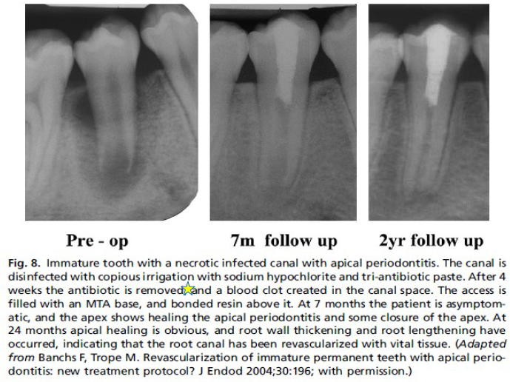

Slide 24
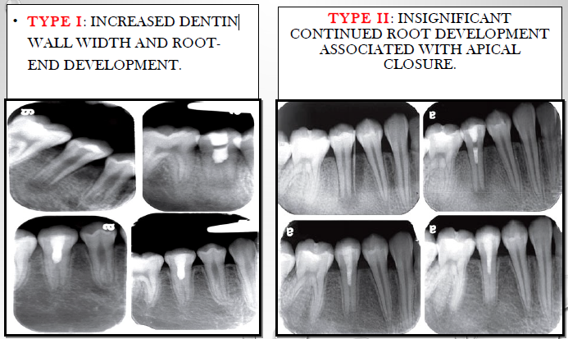
Chen et al immature teeth diagnosed with pulp necrosis and apical periodontitis may present 5 types of revascularization outcome:

Slide 25
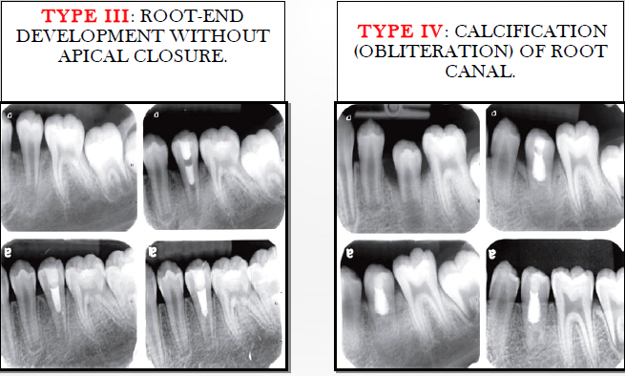

Slide 26
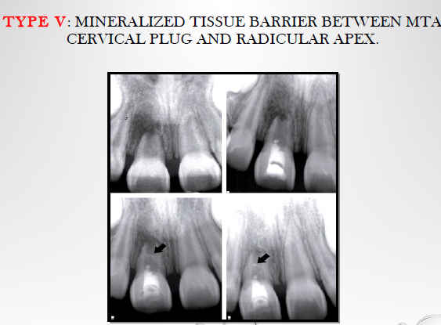

Slide 27
Comparisons with alternative approaches
A number of systematic reviews and studies have shown that treatment of immature teeth with pulp necrosis by either RET or apexification techniques are comparably effective in achieving successful outcomes
•Kahler et al. 2017, Torabinejad et al. 2017, Silujjai & Linsuwanont 2017, Lin et al. 2017.
However, further root maturation can only be achieved in teeth treated with RET
•Bose et al. 2009

Slide 28
Management of immature permanent teeth after failed RET
The treatment of immature permanent teeth after failed RET includes
Regenerative endodontic retreatment (Chaniotis 2017),
Apexification.

Slide 29
One-visit RET
According to AAE and ESE, the protocol of RET usually requires at least two treatment visits
AAE 2016, ESE 2016
However, several case reports of RET have also been successfully treated with one visit without the use of any intracanal medicament.
Shin et al. 2009, McCabe 2015, Chaniotis 2016, Topcuoglu & Topcuoglu 2016

Slide 30
Approaches for regenerative endodontics

Slide 32
TAKE HOME MESSAGE
The clinical success rates of endodontic treatment can exceed 90%, regenerative endodontic methods have the potential for regenerating pulp and dentin tissues and therefore may offer an alternative method to save teeth that may have compromised structural integrity.
However the most challenging aspects of developing a regenerative endodontic therapy is to understand how the various component procedures can be optimized and integrated to produce the outcome of a regenerated pulp-dentin complex
The future development of regenerative endodontic procedures will require a comprehensive research program directed at each of these components and their application to our patients. The unleashed potential of regenerative endodontics may benefit patients.

Slide 33
QUESTIONS
What are different intracanal medicaments used in regenerative endodontics?
What is revascularisation?

Slide 34
REFERENCES
Cohen’s pathway of pulp- first south Asian edition
Grossman’s ENDODONTIC PRACTICE-13th edition
Regenerative Endodontics, SAMI M.A CHOGLE,BDS,DMD,MSD, HAROLD E. GOODIS,DDS, DENTAL CLINICS OF NORTH AMERICA, july 2012,volume 56, number 3.
Regenerative Endodontics: A Review of Current Status and a Call for Action Peter E. Murray, BSc(Hons), PhD,* Franklin Garcia-Godoy, DDS, MS,† and Kenneth M. Hargreaves, DDS, PhD‡JOE — Volume 33, Number 4, April 2007.
Yoshpe M, Einy S, Ruparel N, Lin S, Kaufman AY. Regenerative Endodontics: A Potential Solution for External Root Resorption (Case Series). Journal of Endodontics. 2020 Feb 1;46(2):192-9.
Cymerman JJ, Nosrat A. Regenerative endodontic treatment as a biologically based approach for non-surgical retreatment of immature teeth. Journal of endodontics. 2020 Jan 1;46(1):44-50.
Kim SG, Malek M, Sigurdsson A, Lin LM, Kahler B. Regenerative endodontics: a comprehensive review. International endodontic journal. 2018 Dec;51(12):1367-88.

Slide 35
THANKYOU

